Slide 1
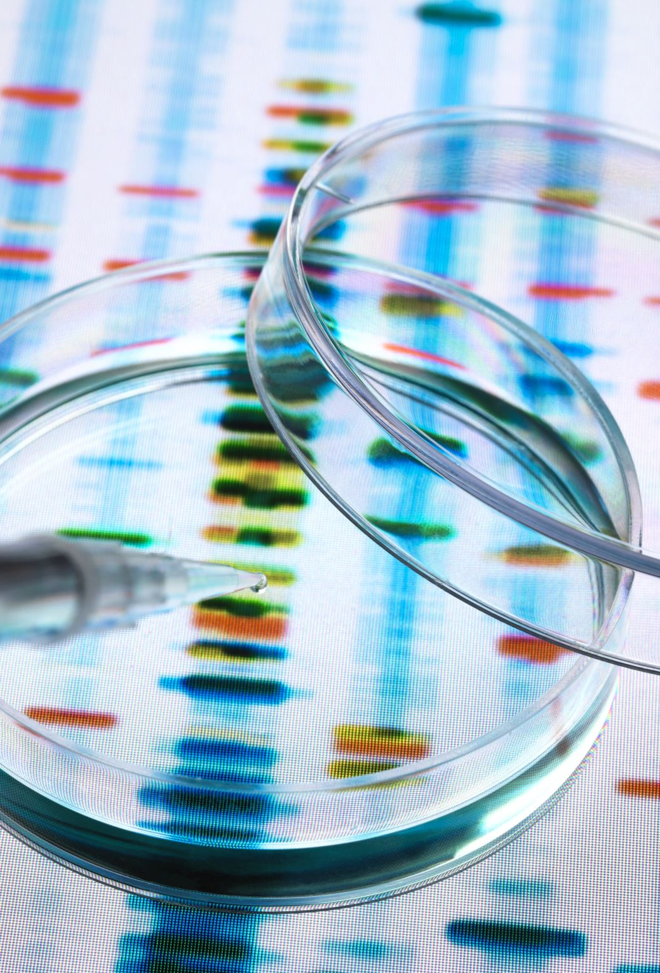
Bioinformatics
Course Overview & Objectives
- Rajkumar Chakraborty, P.hD.

Slide 2
Welcome to the Course!
Hello, and welcome to the course! I'm Rajkumar, your instructor for this bioinformatics journey. With my background in bioinformatics and computational biology, I'm excited to help you dive into this interdisciplinary field.
Bioinformatics is a fast-growing field that combines biology, data science, and computational methods to solve real-world problems.

Slide 3
Course Overview
In this course, we will explore topics like Next-Generation Sequencing (NGS), variant calling, personalized medicine, and machine learning.
By the end, you’ll be able to analyze genetic data, make predictions using machine learning, and understand how bioinformatics is transforming healthcare.

Slide 4
What You Will Learn
Linux and Python basics for bioinformatics workflows.
How to work with NGS data and call variants.
How to annotate and interpret variants.
How personalized medicine tailors treatments based on genetic data.
How to apply machine learning techniques to biological problems.

Slide 5
Course Modules
Module 1: Introduction to Linux & Python
Learn the essential tools needed for bioinformatics.
Module 2: NGS & Variant Calling
Understand how to process NGS data and detect genetic variants.
Module 3: Personalized Medicine
Explore how genetics influence medication choices.
Module 4: Machine Learning in Bioinformatics
Apply machine learning to biological datasets.
Module 5: Capstone Project
Integrate all the skills in a comprehensive project.

Slide 6

Hands-On Learning
Throughout the course, you’ll engage in hands-on activities like setting up a bioinformatics pipeline, analyzing sequencing data, and building a machine learning model.
The capstone project will allow you to solve real-world problems using bioinformatics.

Slide 7
Tools You’ll Use
Linux for running bioinformatics pipelines.
Python with libraries like Biopython, Pandas, and scikit-learn.
NGS tools like BWA and GATK for variant calling.
Machine learning tools like scikit-learn for data analysis and modeling.

Slide 8
What We Expect from You
Attend classes regularly and participate in discussions.
01
Submit assignments and projects on time.
02
Approach the course with curiosity and engage in hands-on activities.
03

Slide 9
Resources for Learning
We’ll use a variety of resources including research papers, software tools, and databases like NCBI and 1000 Genomes.
Make sure to set up your environment by installing Linux and Python, and get familiar with these tools early on.

Slide 10
Cool Applications in Bioinformatics
Personalized Cancer Treatment: Understanding a patient’s genetic mutations helps doctors select the most effective treatments.
Autism Mutation Detection: Researchers use bioinformatics to identify genetic mutations associated with autism.
Predicting Drug Efficacy: Machine learning models predict how patients will respond to specific drugs based on their genetic makeup.

Slide 11
First Steps
Set up a environments on your system.
Explore basic Linux commands and familiarize yourself with Python syntax

Slide 12

Questions?
Feel free to ask any questions about the course structure, expectations, or tools we’ll be using.
What excites you the most about bioinformatics?

